Slide 1
IP Project Apartment Maintenance System (AMS)
By Sree Harissh & Team

Slide 2
Agenda
1
Project - Overview
2
Functionality
3
Look & Feel
4
Tools & Technology
5
Question & Answer

Slide 3


Slide 4
Overview
The project we took is to develop a web application to maintain the administrative tasks of Apartments.
Currently in most of the apartments association, the accounts, payments, apartment details, meeting details are not properly maintained or kept in papers in an irregular manner.
This project helps the apartment association with a hassle free method to handle their administrative tasks. Also helps to keep the history records and information in a proper way so that the flat owners can easily view the information.

Slide 5


Slide 6
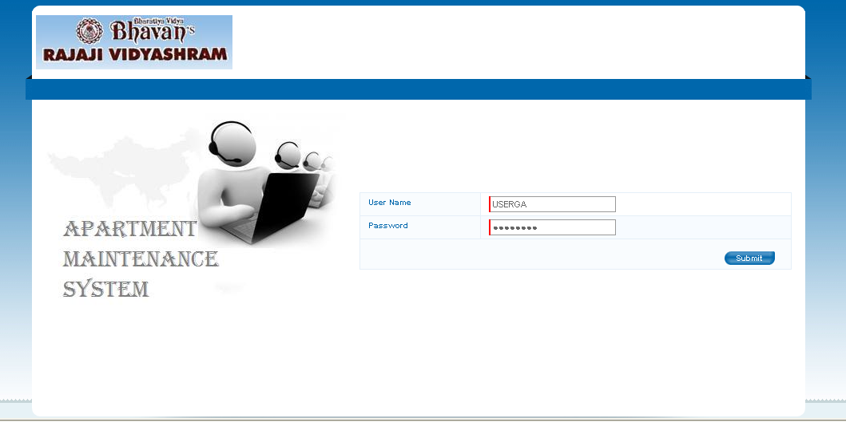
AMS – Functionality
The Apartment Maintenance System is modularized into following five major modules.
      User Administration
      Apartment Management
      My Portfolio
      Info Center
      Reports
Sample Login Screen

Slide 7
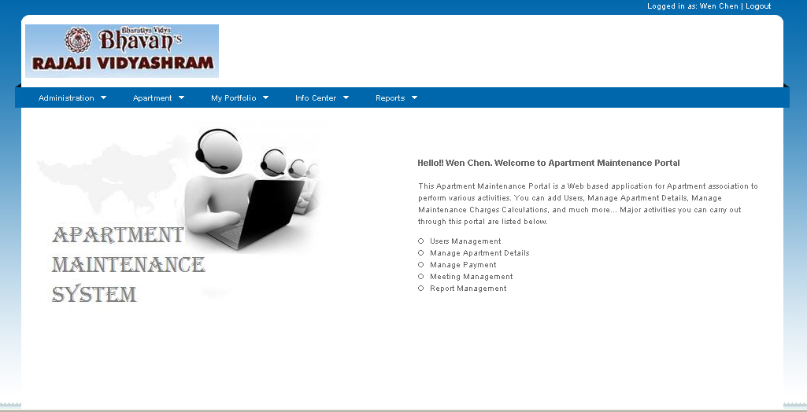
AMS – Home Page
The home page of Apartment Maintenance System has all the modules main menu. The user can click the required menu item to perform their tasks. The main menus are as follows.
      Administration
      Apartment
      My Portfolio
      Info Center and
      Reports
      A sample Home page screen shot is shown next….
Sample Home Page

Slide 8
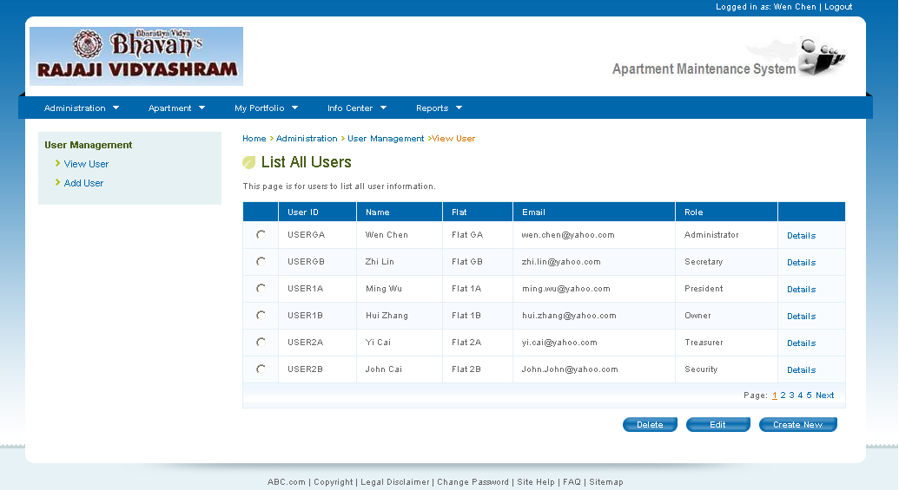
AMS – Administration Functionality
The Administration functionality is to manage the users of the application. The sub menus of this functionality are as follows.
      View user
        This helps the administrator to view the details of each users. They can select the users and modify If required.
      Add User
        The administrator of the application can add new user for this application using this functionality
      A sample View User page screen shot is shown next….
The User Administration module of AMS has
      View User
      Add User

Slide 9
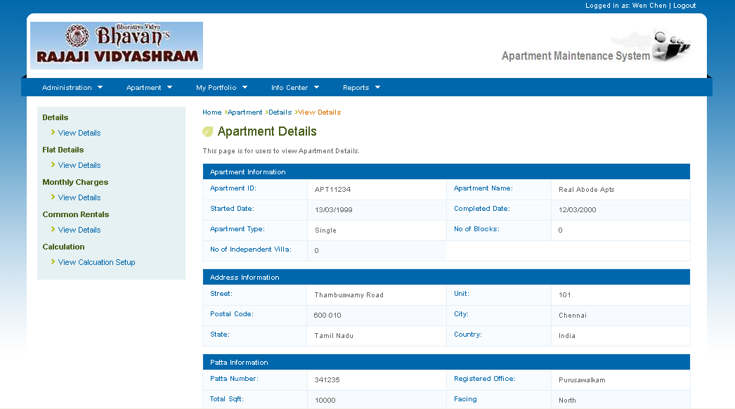
AMS – Apartment Management
The Apartment Management functionality is to view and update the apartment, flat, monthly charges details by the administrator. The sub menus of this functionality are as follows.
      View Apartment details
        This helps the administrator to view and modify the apartment details in the application.
      Flat Details
        The administrator of the application can view and update the flat details.
      Monthly Charges
        The average / estimated monthly expenses are updated using this function for maintenance charges calculation
      Common Rentals
        The monthly common rental incomes are updated using this function for maintenance charges calculation
      Calculation Setup
        The maintenance charges calculation setup are carried out in this function to perform the flat monthly maintenance charges
      A sample Apartment Management screen shot is shown next….
The Apartment module of AMS is for user to
      View & Edit
        Apartment Details, Flat Details, Monthly Charges & Common Rentals
      Setup Maintenance charge calculation

Slide 10
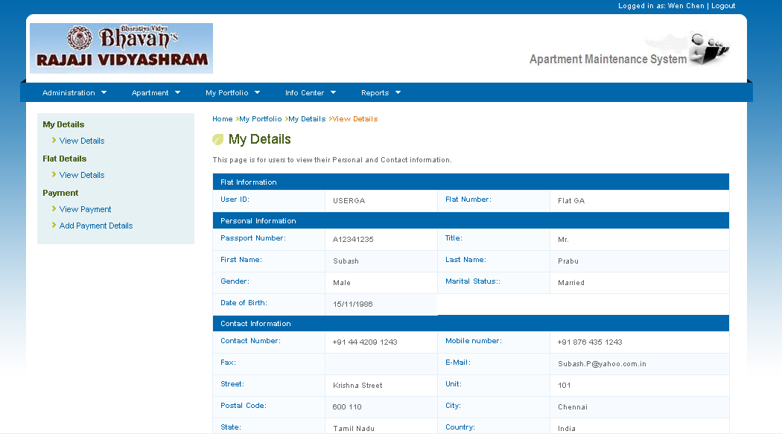
AMS – My Portfolio
The My Portfolio functionality is to view and update the Owners personal details like contact information, additional address information, etc. The sub menus of this functionality are as follows.
      My details
        This helps the owners to view and modify the their personal / Contact details in the application.
      Flat Details
        The Owners can view and update more information of the flat.
      Payment
        The owners can view their payment details. The administrator can add the maintenance payment information of flat owners
      A sample My Portfolio screen shot is shown next….
Owners details, Flat additional details and payment can be viewed / edited through this functionality
      My Details
      Flat Details
      Payment

Slide 11
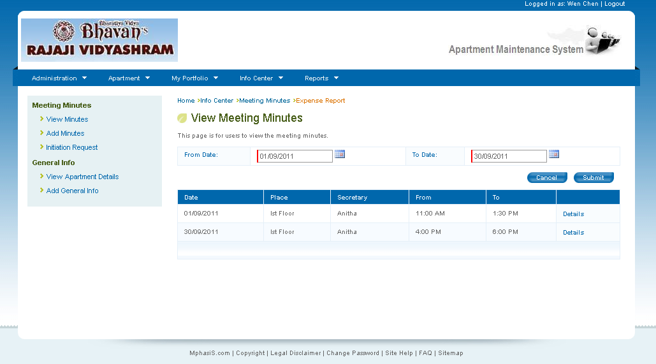
AMS – Info Center
The Info Center functionality is the place where users can view meeting minutes and apartment general information. The sub menus of this functionality are as follows.
      Meeting Minutes
        This helps the owners to view meeting minutes details in the application. The administrator can add / update the meeting minutes.
      General Info
        The Owners can view general information of the apartment.
      A sample Info Center screen shot is shown next….
Users to view the meeting minutes and also to view the general apartment information.
      Meeting Minutes
      General Info

Slide 12
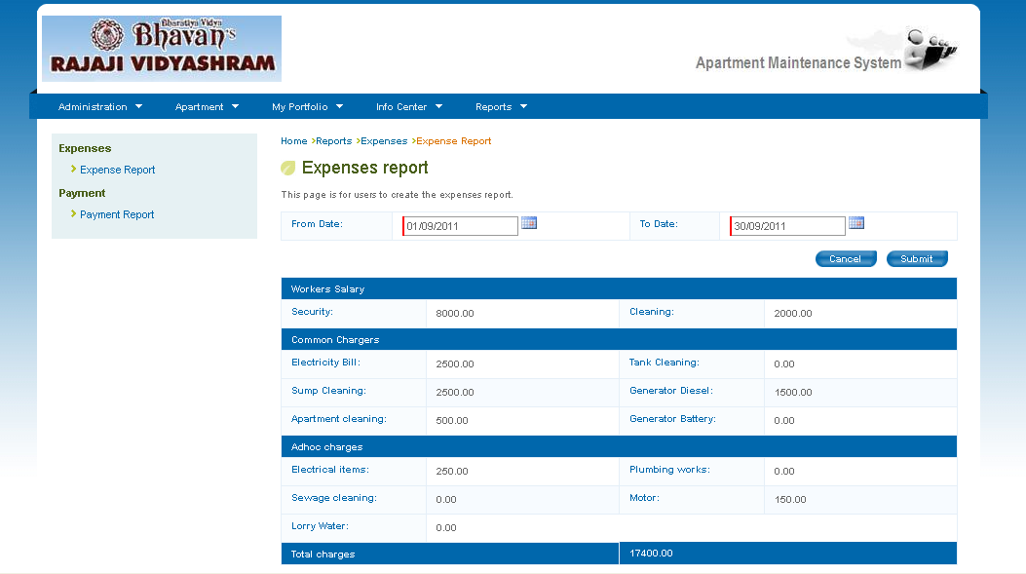
AMS – Reports
The Reports functionality helps users to create expense and payment reports from the application. The sub menus of this functionality are as follows.
      Expenses Report
        This is for users to view the expenses made for the selected period of duration.
      Payment Report
        The maintenance payment details can be generated from this functionality for the selected duration.
      A sample Report screen shot is shown next….
Users can generate the following reports.
      Expense report
      Payment report

Slide 13


Slide 14
Tools & Technology
Sl.No | Technology /Tool | Comments
1 | Classfish | Application will be deployed on Classfish server.
2 | MySQL | Database used for this project
3 | Netbeans | IDE for application Developement
4 | JSP | Frontend pages of this application
5 | Textpad | HTML design
Jan 2010

Slide 15
Q & A

Slide 16


